Slide 1
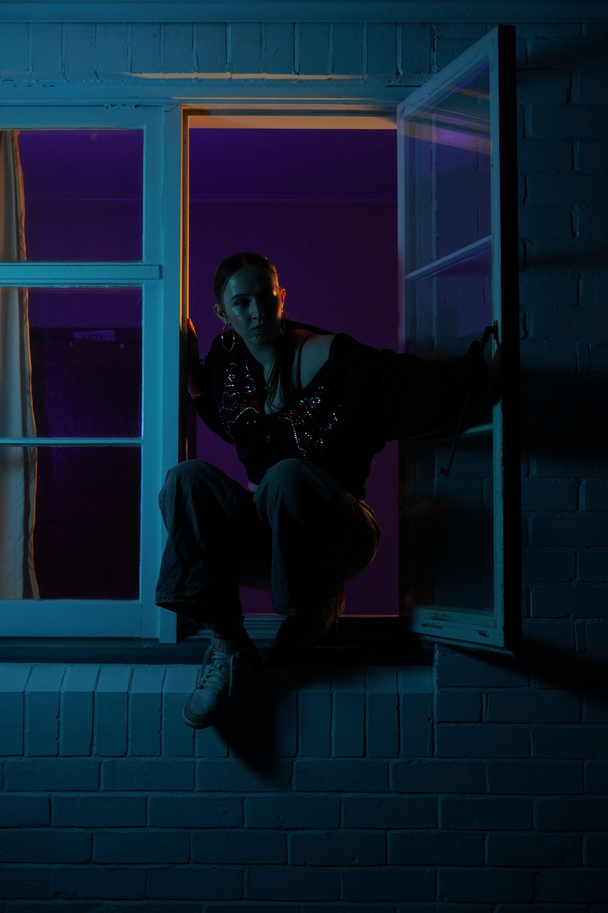
Broken Vessel
A film by Alyssa Murphy
Press Kit

Slide 2
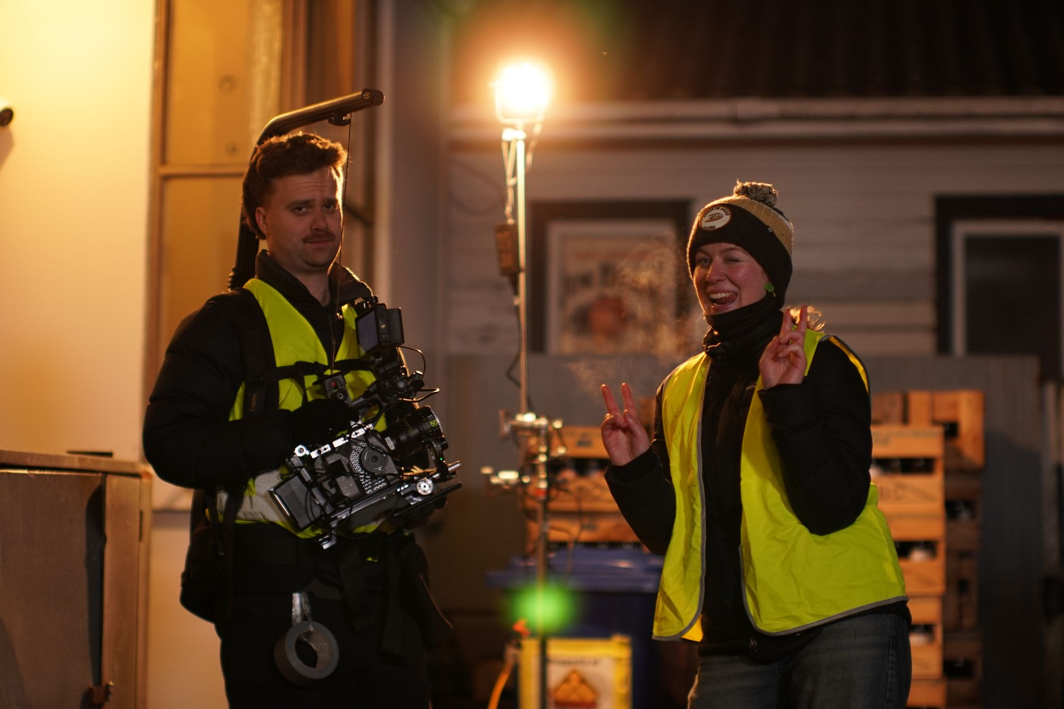
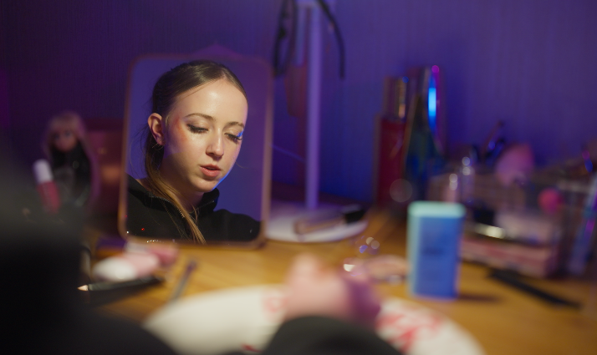
Logline
Feisty teenage girl Brooklyn emotionally struggles with constant bad decisions, impulsive escapism, and drug use; she makes the decision to change when she realises she is losing the people that really matter.
Directed by
Alyssa Murphy
Produced by
Joshua Kent
Junxi Cao
Cinematography by
Caleb Gilbert
Starring
Ella-Rose Murphy
Rubens Prisco
Brooke Mellsop
Title: Broken Vessel
Genre: Coming-of-age, Martial arts
Country: New Zealand
Language: English
Duration:
Aspect ratio:
Shooting format: Sony fx6
Exhibition format: 4k DCP
Sound: 5:1, stereo
Colour

Slide 3
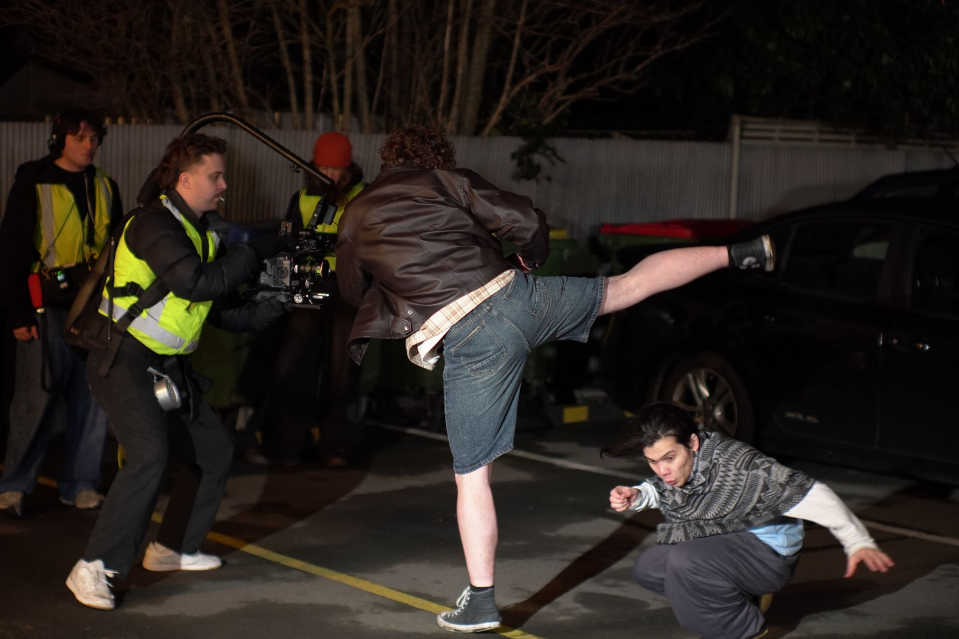
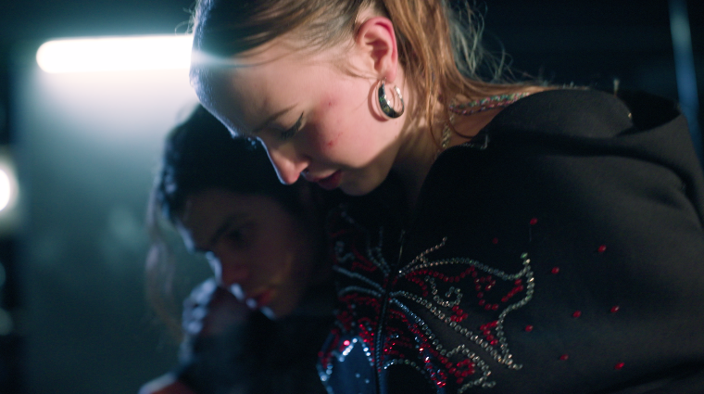
Synopsis
Broken Vessel is a 11-minute coming-of-age, action short film. This is our 4th year honours project at the University of Canterbury. The story is about a rebellious, feisty teenage girl, Brooklyn, who is struggling with her emotions and home life, and her Kungfu/ Taichi practicing neighbour, and longtime best friend, Ren. They are opposite personalities but balance each other. As Brooklyn is turning down a very different path to Ren, his worry for her puts tension on their friendship. We see Brooklyn throughout the story fight with her mum, fight with her best friend, explore escapism, drug use and strong emotional moments, and then we come to Brooklyn making an understanding through finding sympathy for her mum, and choosing to be different to her. She decides to use meditation to calm down and at the end we see her changed, and an apology to her best friend.

Slide 4
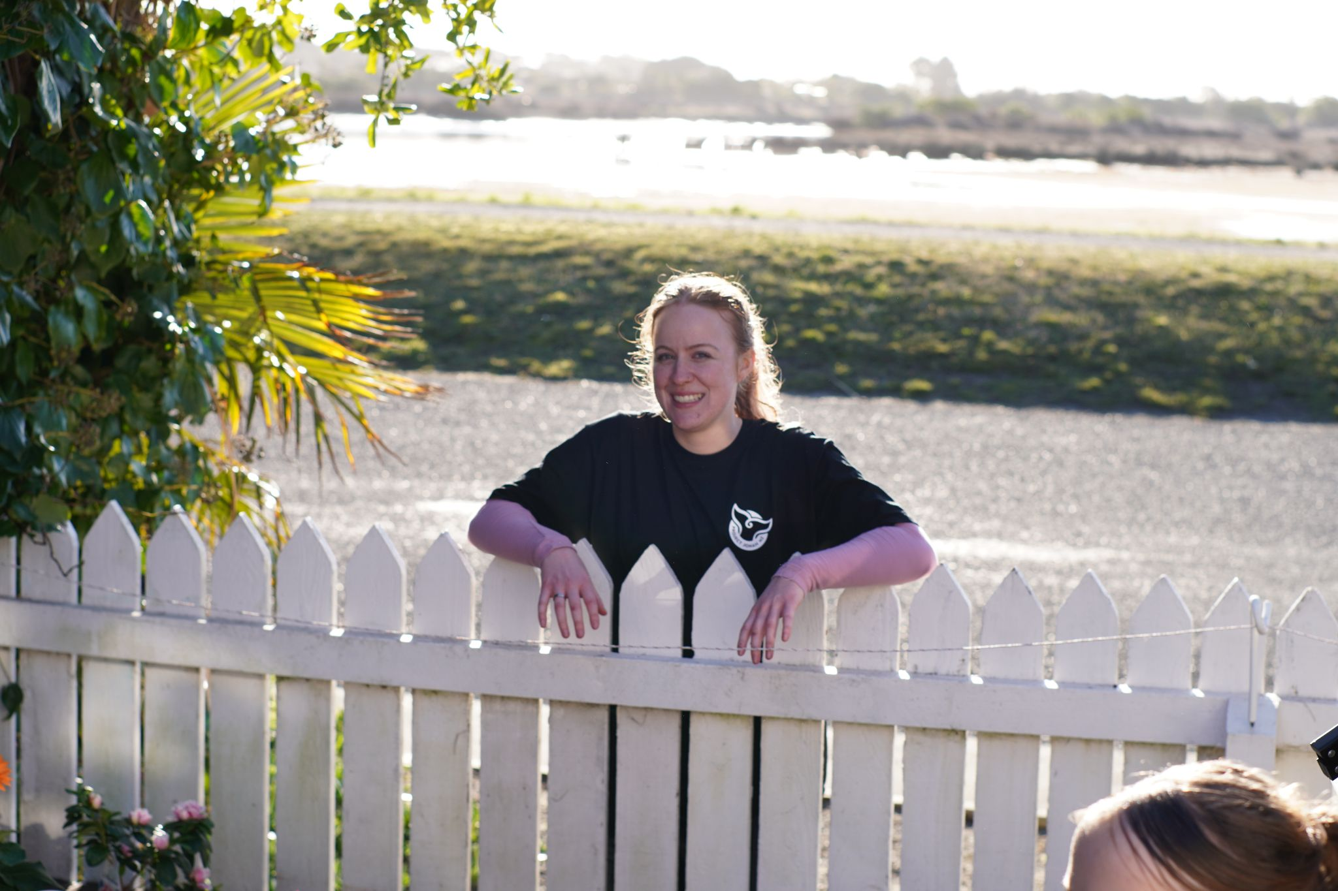
Director statement
Broken Vessel at its core is about a teenage girl, Brooklyn, who is struggling to navigate her emotions while growing up in an environment with added hardship of poverty, instability, and neglect.
I was drawn to this idea because I wanted to explore the emotional depth and complexity of being a teenage girl, and I wanted to make a film that could help other girls who watch this feel represented, and for myself to explore uncomfortable and confusing topics that we go through growing up.
Alyssa Murphy, Director

Slide 5
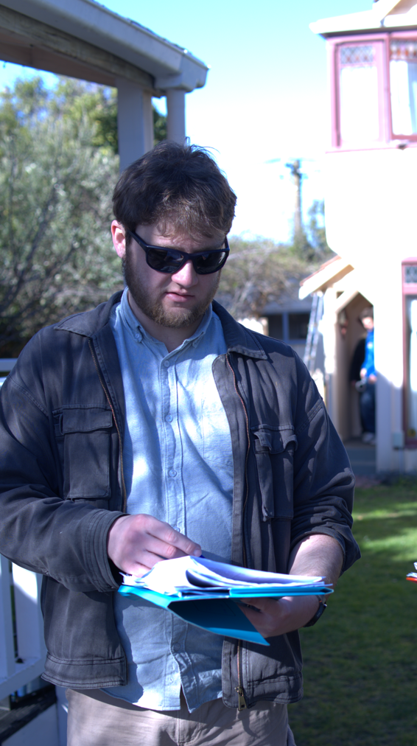
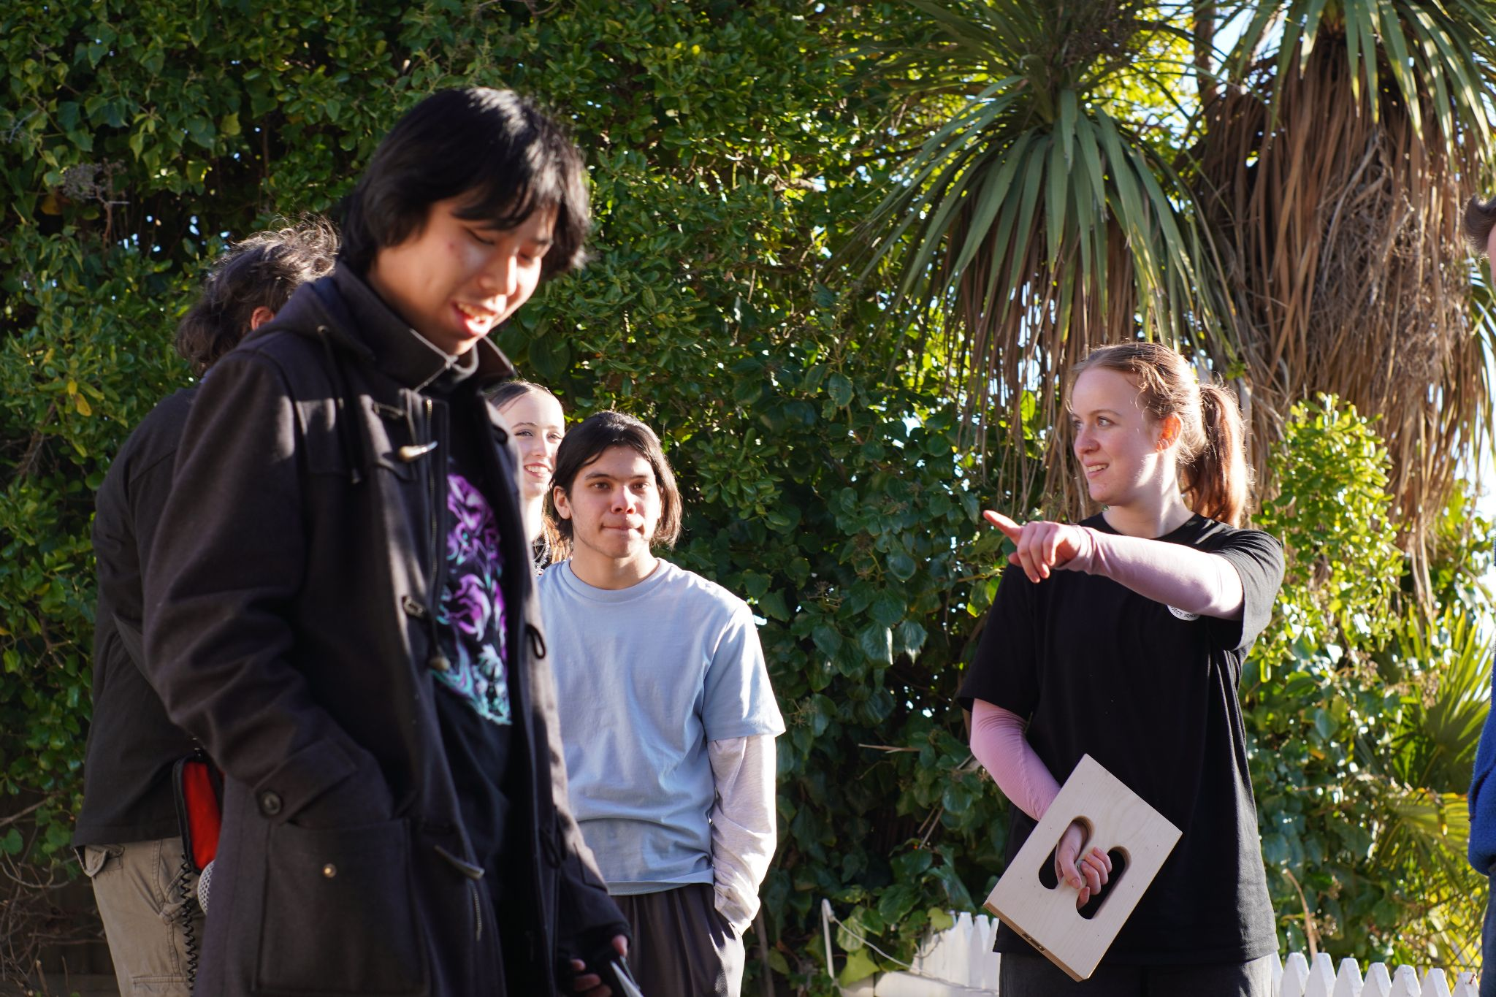
Producer statements
I am very grateful to have worked on this project with Alyssa Murphy to achieve her vision.
I admire how Alyssa strived to do her very best for her project from getting funding from Boosted and the Christchurch Casino to recruiting an effective crew to carry out her work.
Broken Vessels is an inspiration and example for those that want to make a film can succeed through hard work and perseverance.
Junix Cao, Co-Producer
Broken Vessel was such a joy to work on. Giving a genre a New Zealand twist is something that I think sets this project apart from many others. The project has a distinct voice and I am glad that I had the opportunity to produce it.
Another point of difference that Broken Vessel offered was the opportunity to work with local stunt performers. Rubens and the other trained professionals showed such an eagerness towards the film and went above and beyond to make the action authentic and believable.
Joshua Kent, Co-Producer

Slide 6
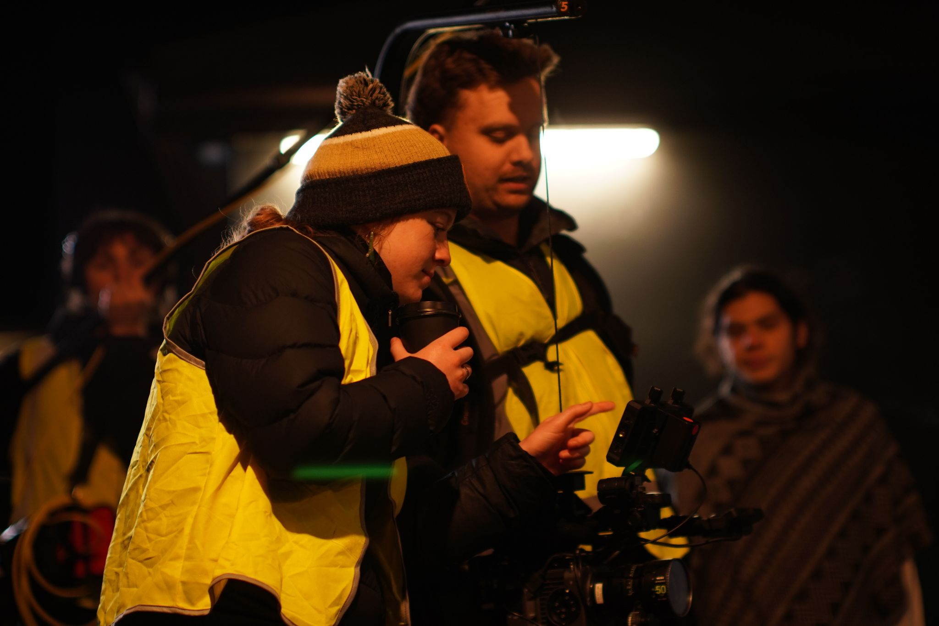
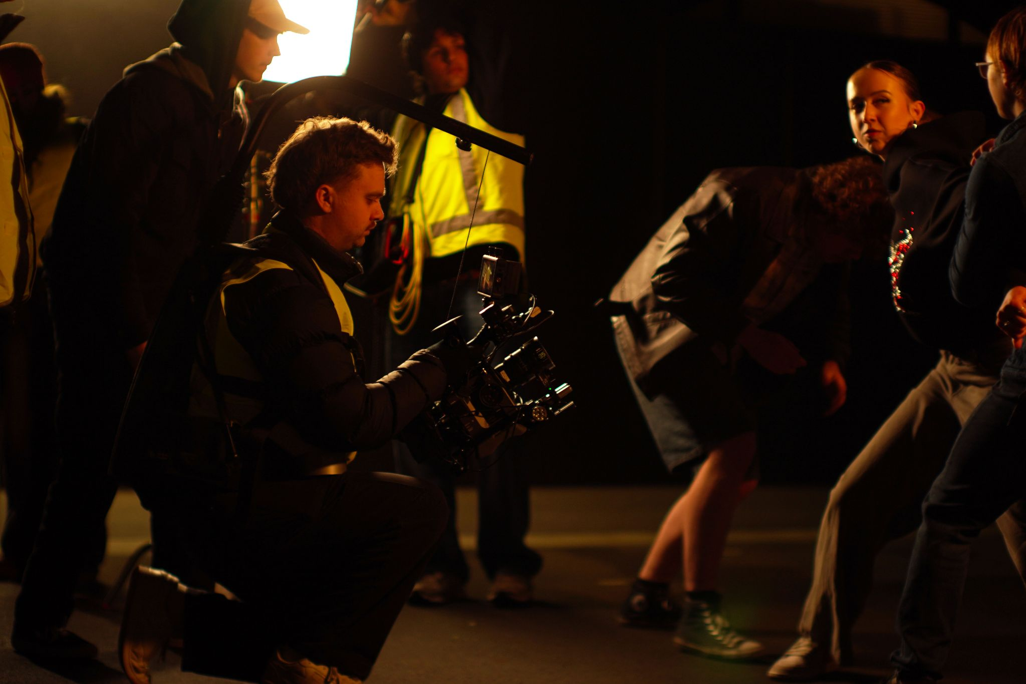
Director of photography statement
Broken Vessel was an incredible project to be a part of. Working with Alyssa allowed me to express my voice as a cinematographer, and pursue interesting and exciting avenues for helping to tell her story.
I was drawn to Broken Vessel because I felt it had a distinct visual style, and with Alyssa’s clear directorial voice, I feel that we were able to get the best out of her script and approach shooting this film in a way that made the shoot incredibly enjoyable.
Caleb Gilbert, Director of Photography

Slide 7
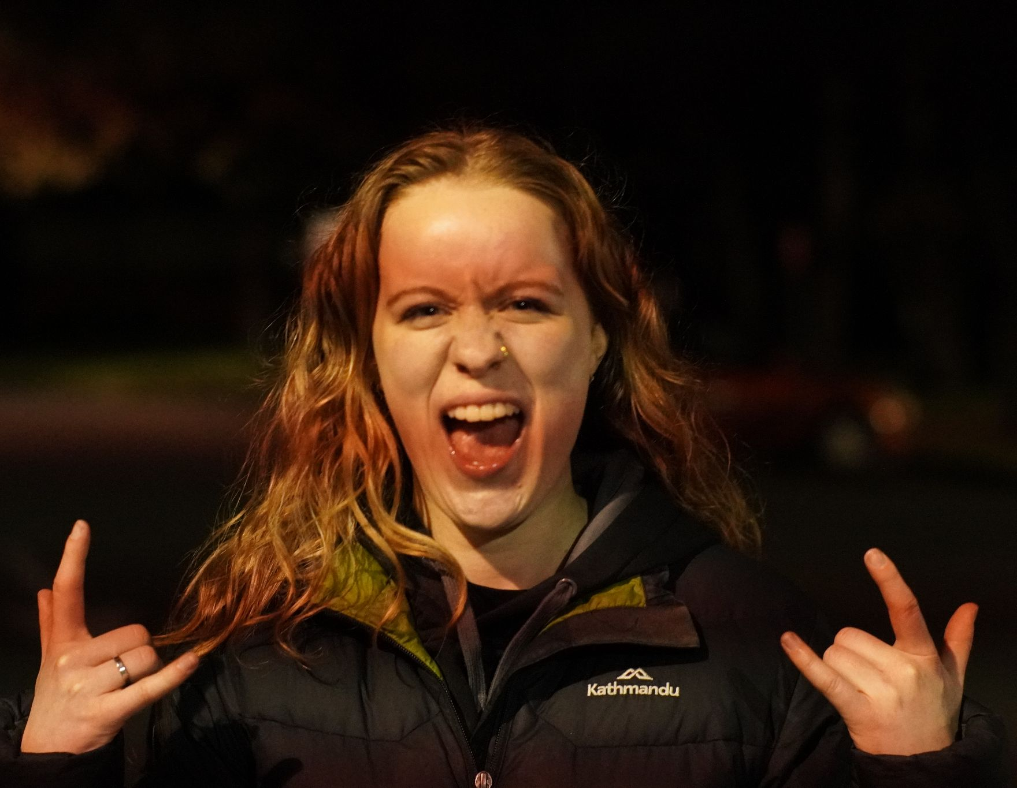
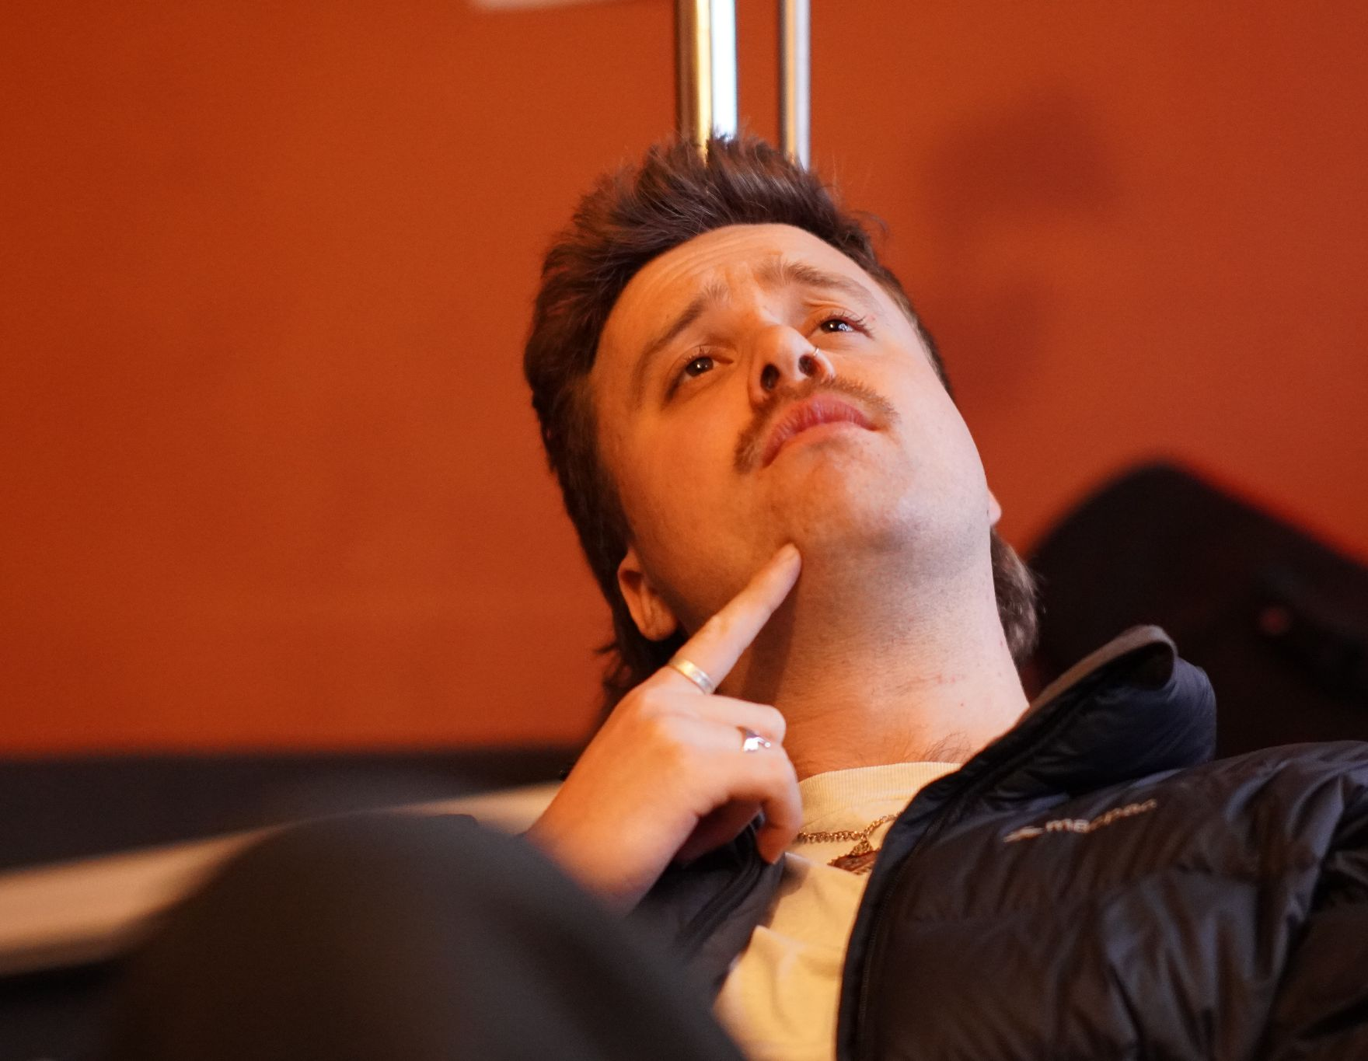
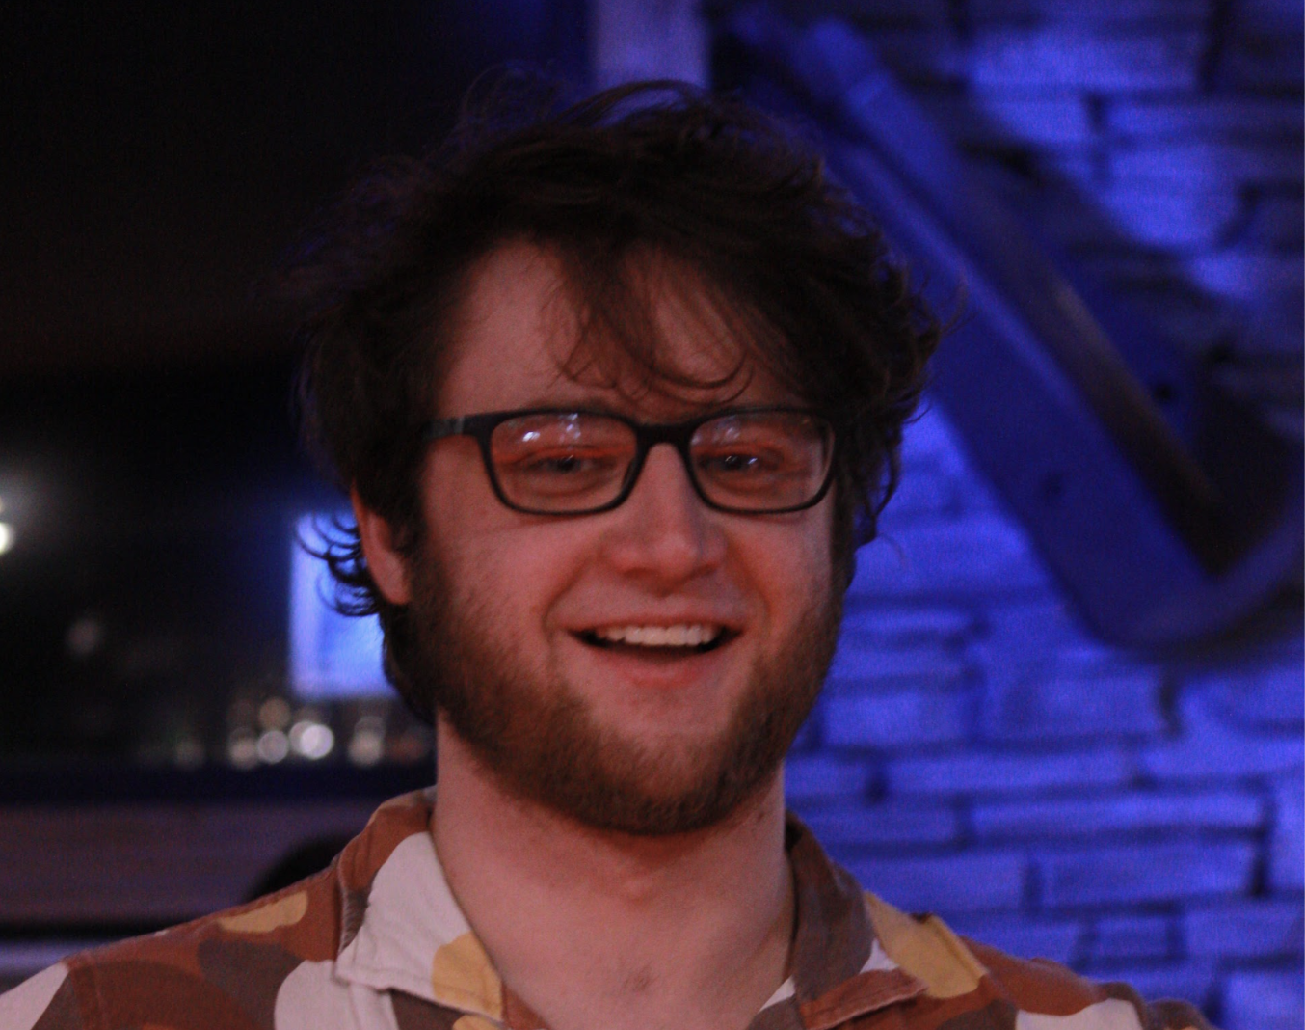
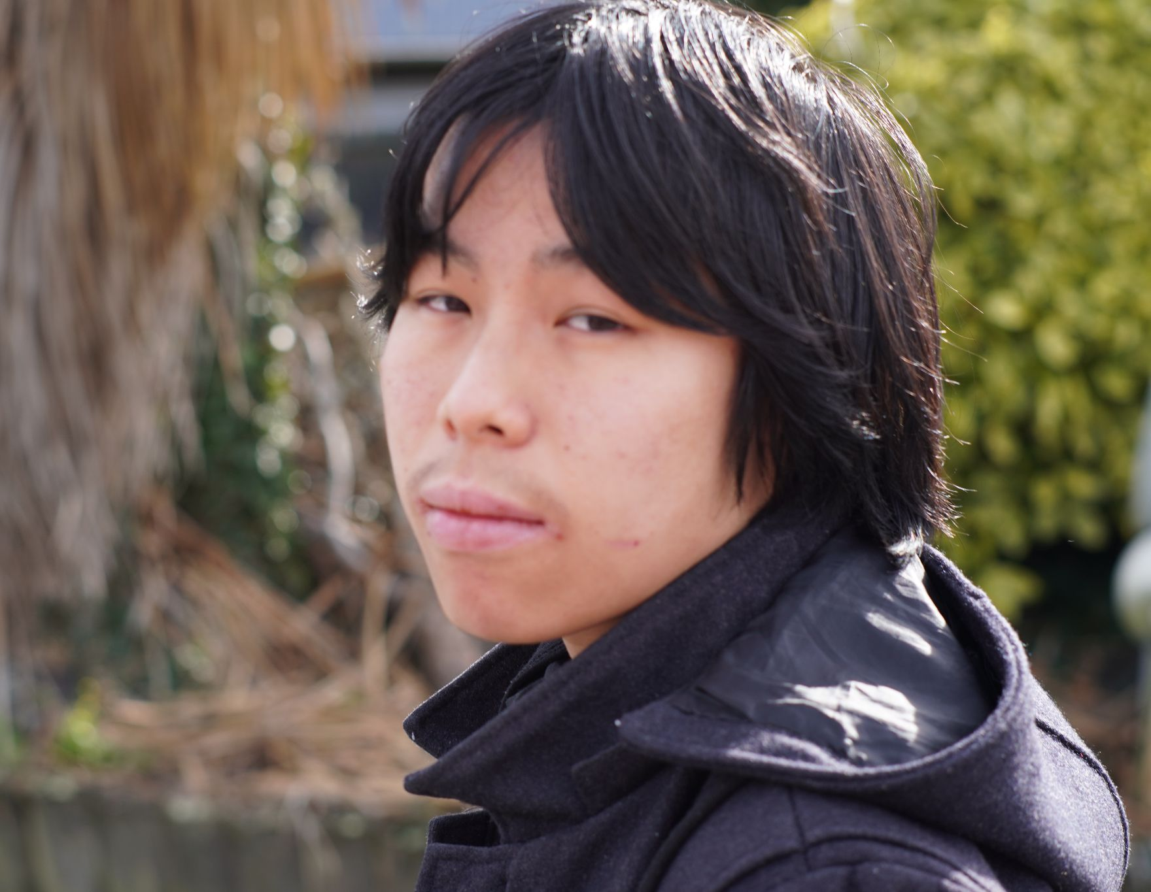
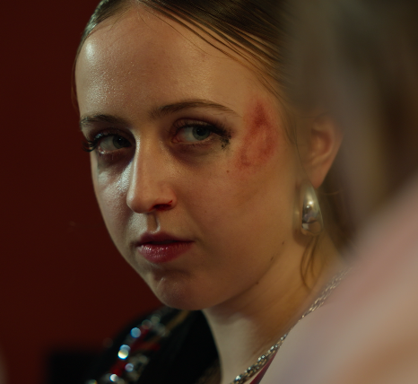
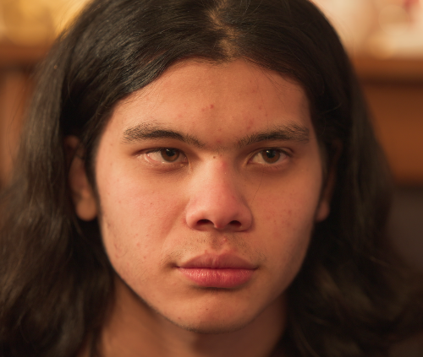
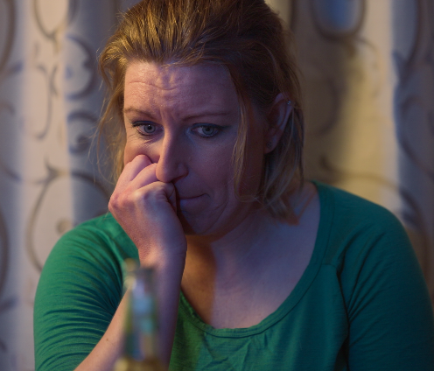
Key Crew
Cast
Alyssa Murphy
Director / Writer / Editor
alyssamurphynzp@gmail.com
+64 22 1885868
Caleb Gilbert
Director of Photography
caleblukeg@gmail.com
+64 22 169 8463
Junxi Cao
Co-Producer
abyssai493@gmail.com
+64 27 274 7362
Joshua Kent
Co-Producer
Joshua.kent787@gmail.com
+64 21 124 5503
Ella-Rose Murphy
Brooklyn
Rubens Prisco
Ren
Brooke Mellsop
Amy

Slide 8
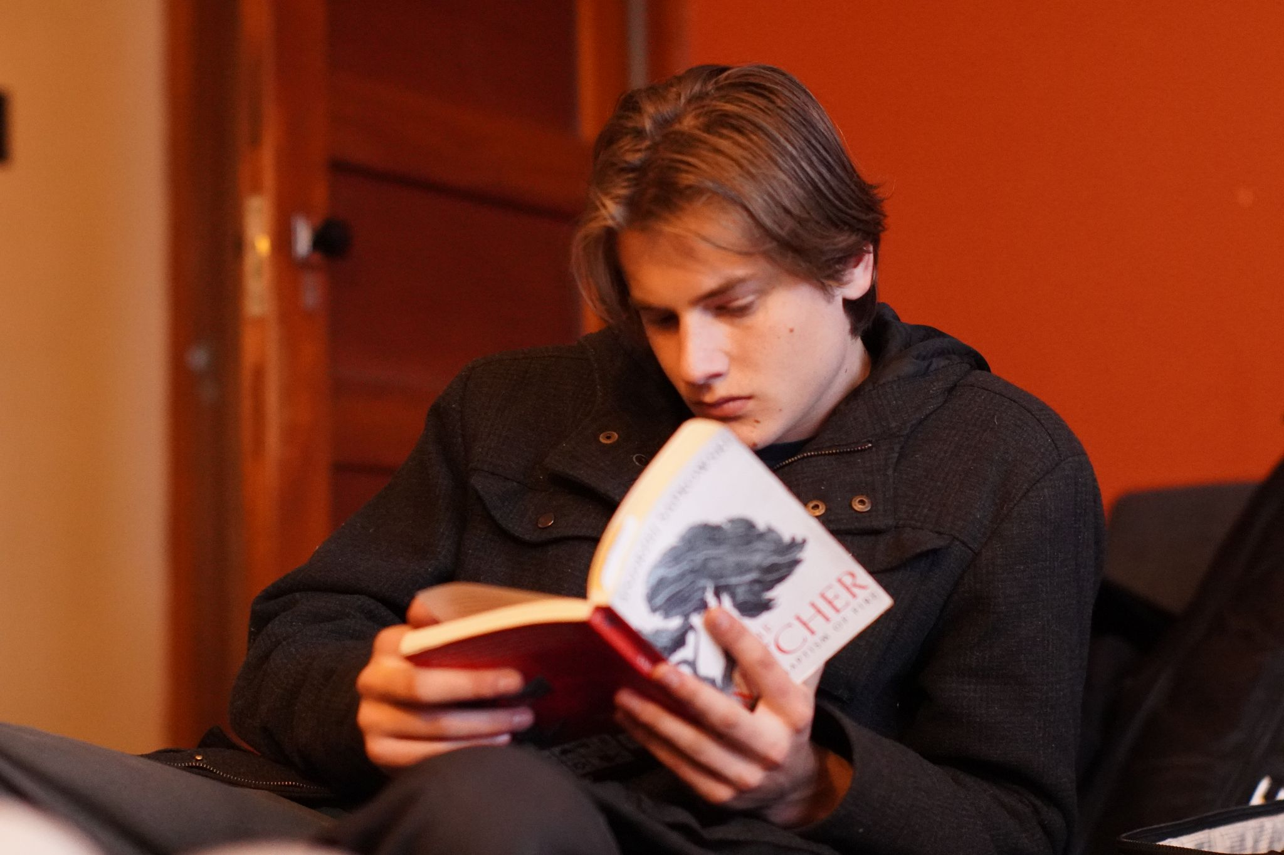
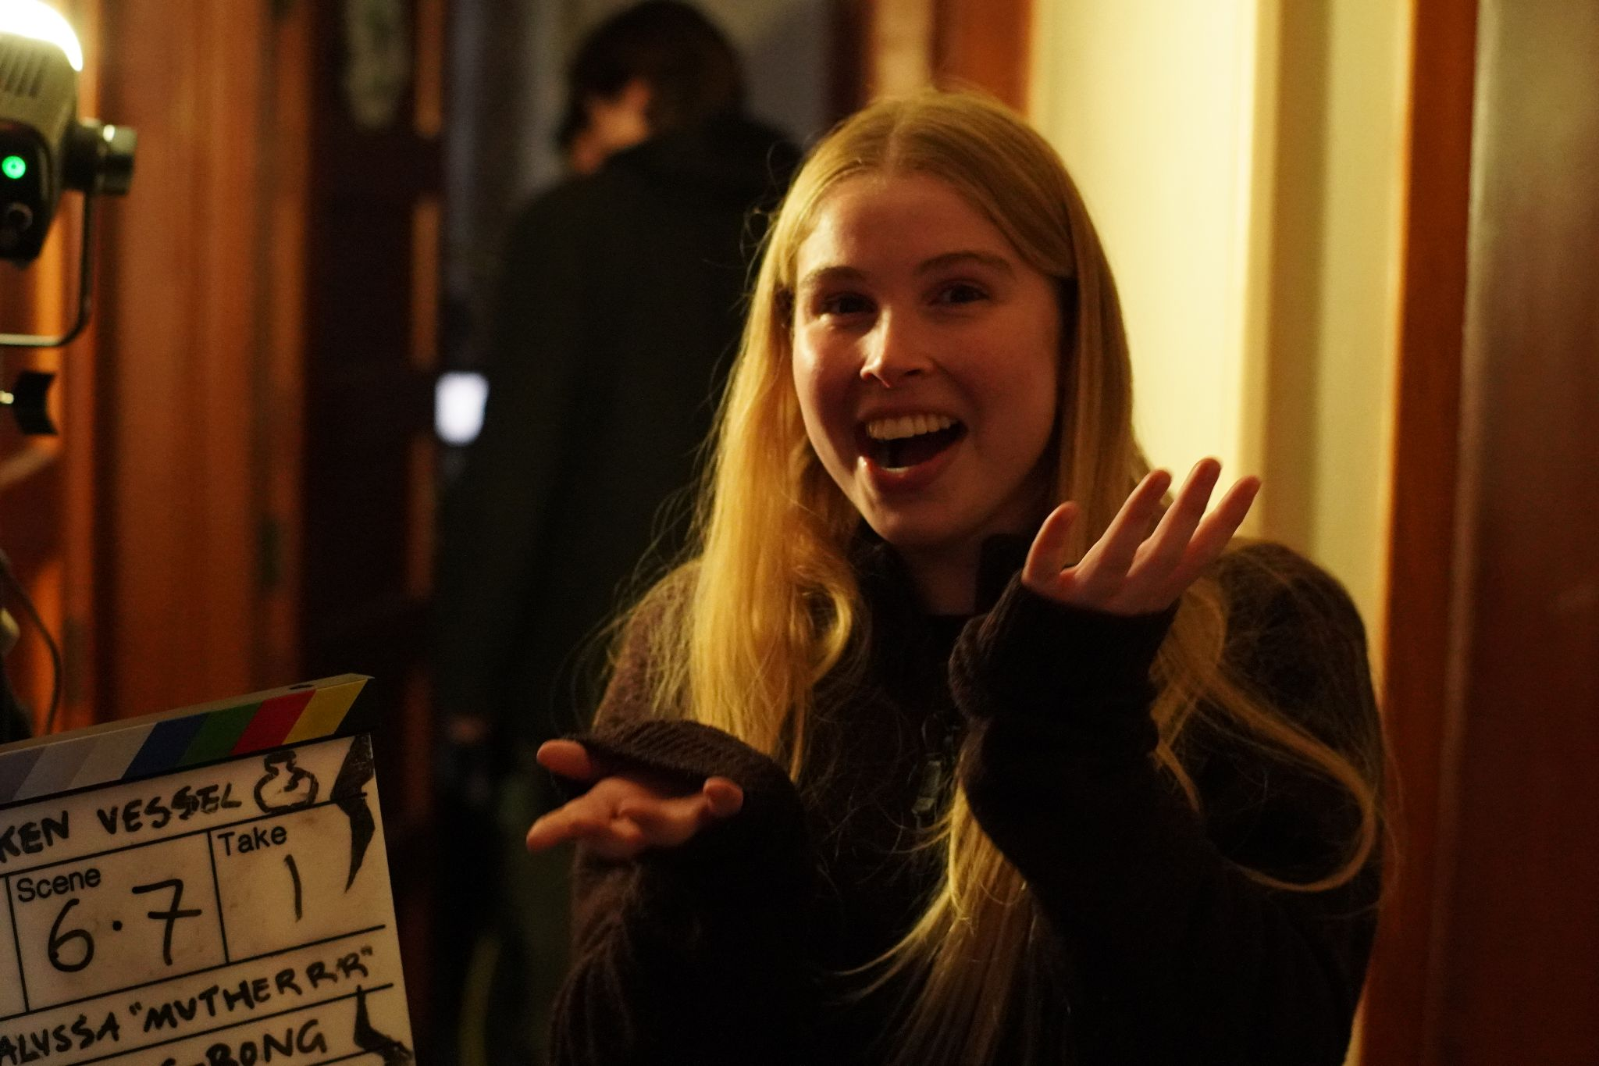
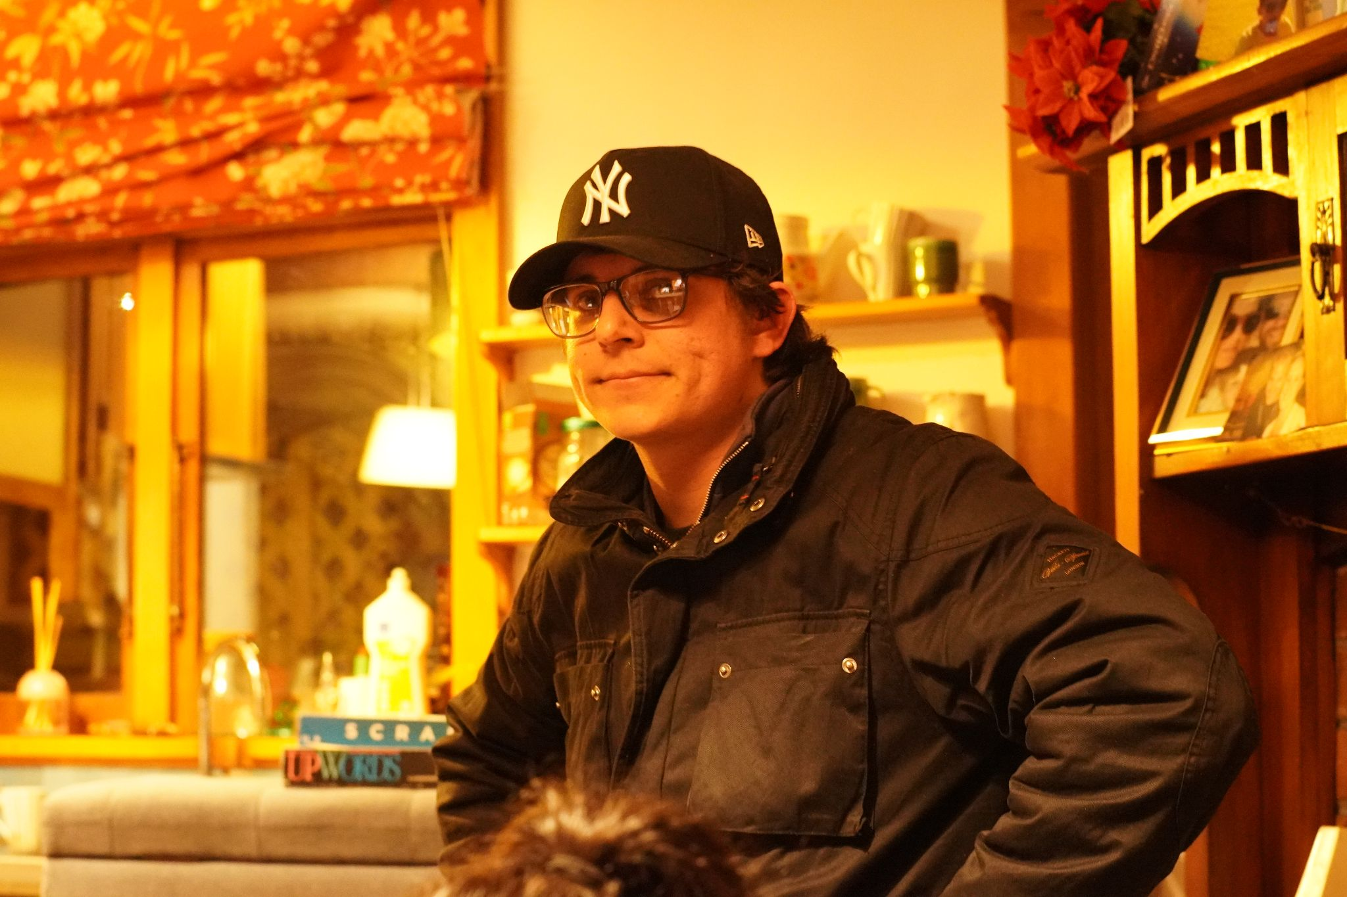
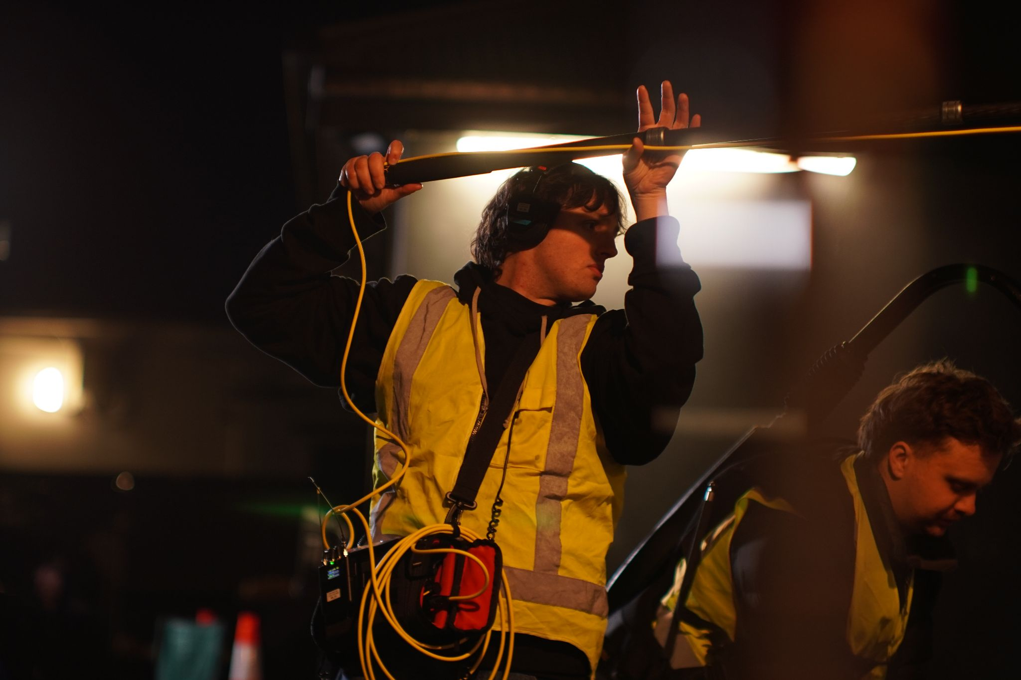
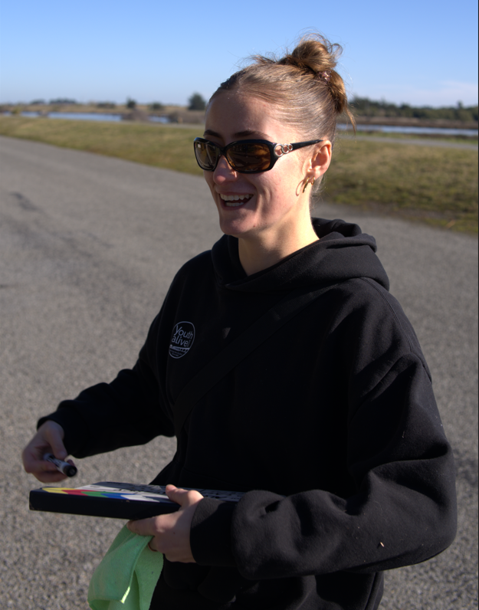
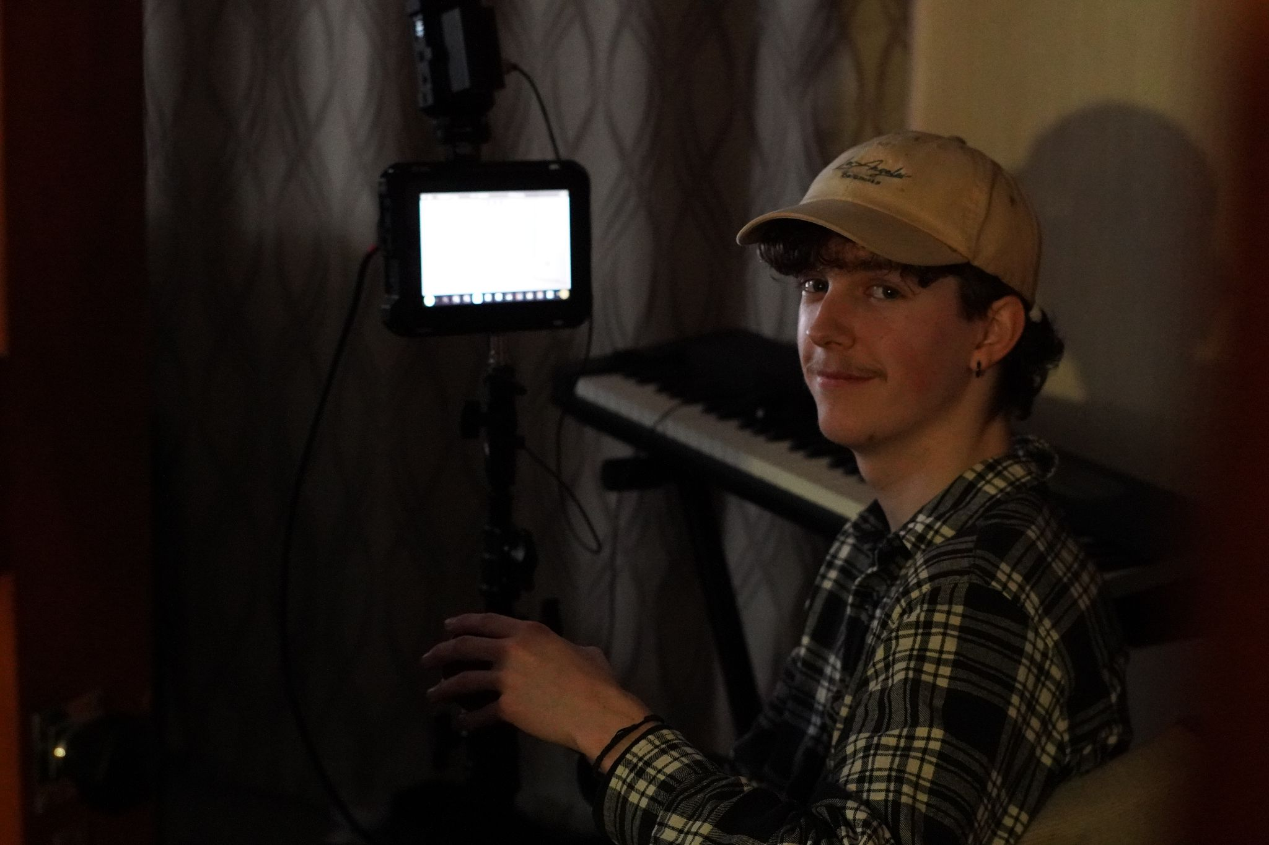
Credits
Key Crew
Directed by
Alyssa Murphy
Written by
Alyssa Murphy
Produced by
Junxi Cao
Joshua Kent
Director of photography
Caleb Gilbert
Cast
Brooklyn
Ella-Rose Murphy
Ren
Rubens Prisco
Amy
Brooke Mellsop
Man 1
Xavier Boesse
Man 2
Austin Cook
Child 1
Sandi Buwanayake
Child 2
Radin Buwanayake
Kevin (voice)
Danny Rey-Conde
Minor crew
Assistant Director
Caoimhe Hungerford
Stunt Supervisor
Susan Sun
Stunt choreography
Zac Song
Assistant Camera
Ranger Leary
Natdanai Varnakomala
Gaffers
Declan Lang
Jack Robinson
Ben Dykes
Brodie Simpson
Continuity
Ayesha Downes
Art Department
Freya Carson
Ahn Nahm
Makeup
Siobhan Hoare
Lucy Wills
Sound recording
Jacob Webb
ADR recording
Jiro Ibarra
BTS photography
Edison Halliday
Props
Freya Carson
Ahn Nahm
Kerry Murphy
Julian Murphy
Ella-Rose Murphy
Hikurangi Maikuku
Sound mix polish
Dylan Jonkers
Composer
Hamish Robinson
Boosted mentor
Poe Tiare Tararo

Slide 9
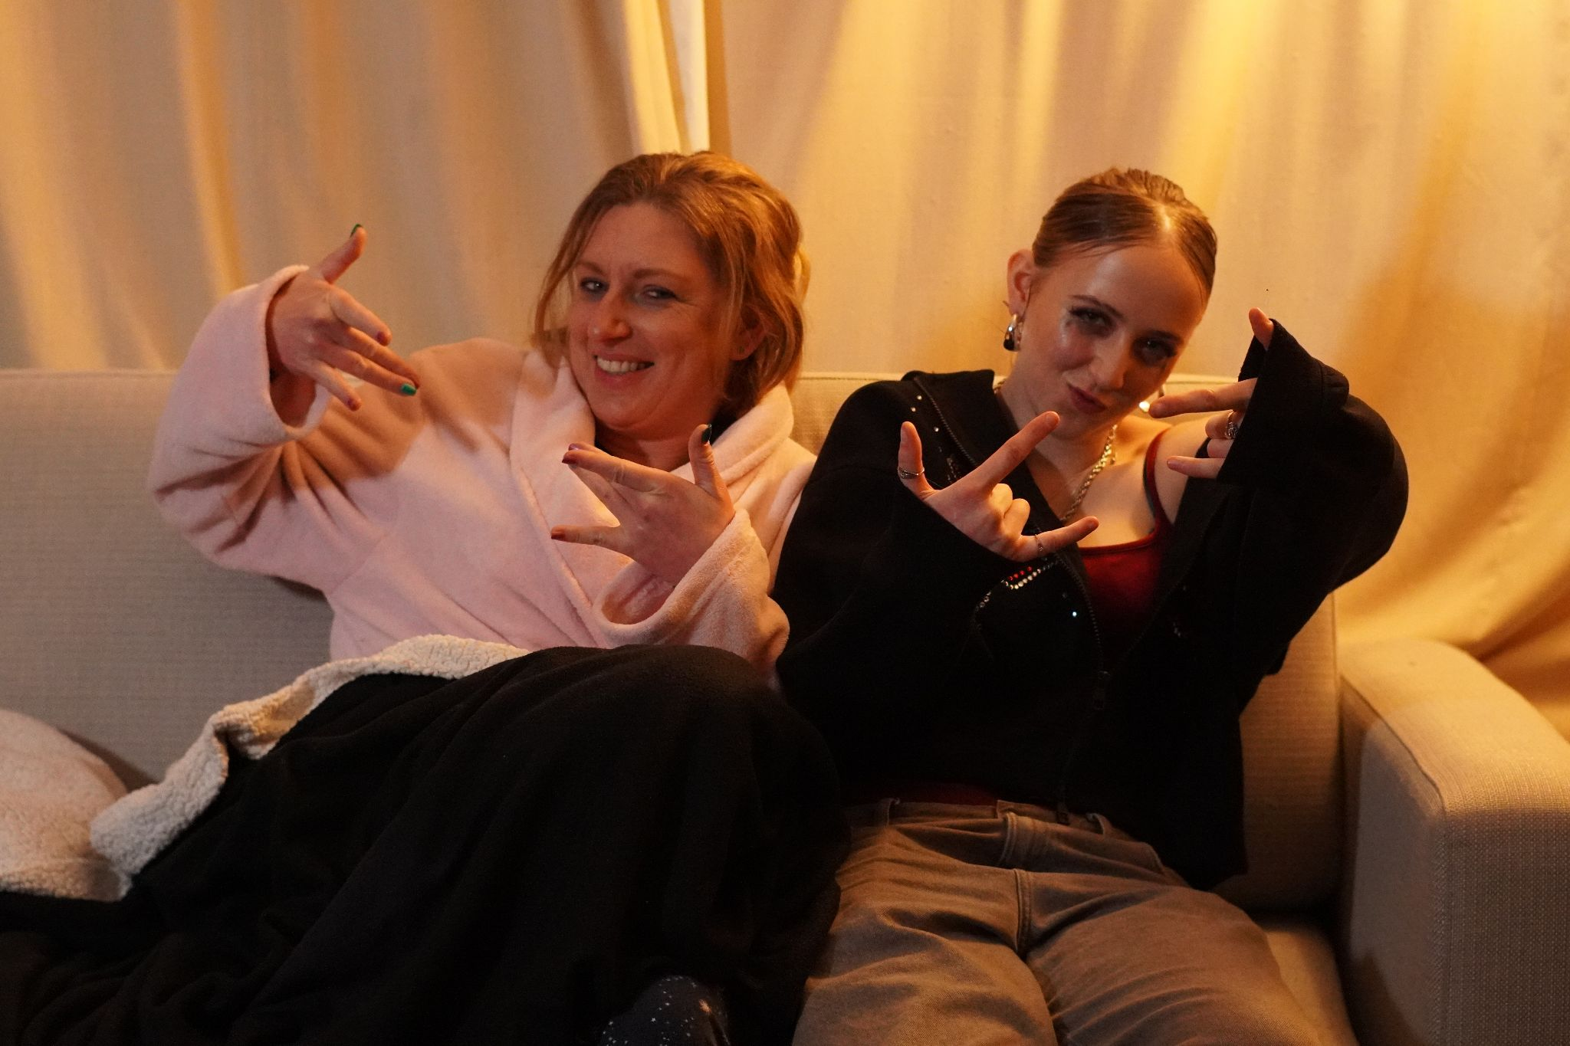
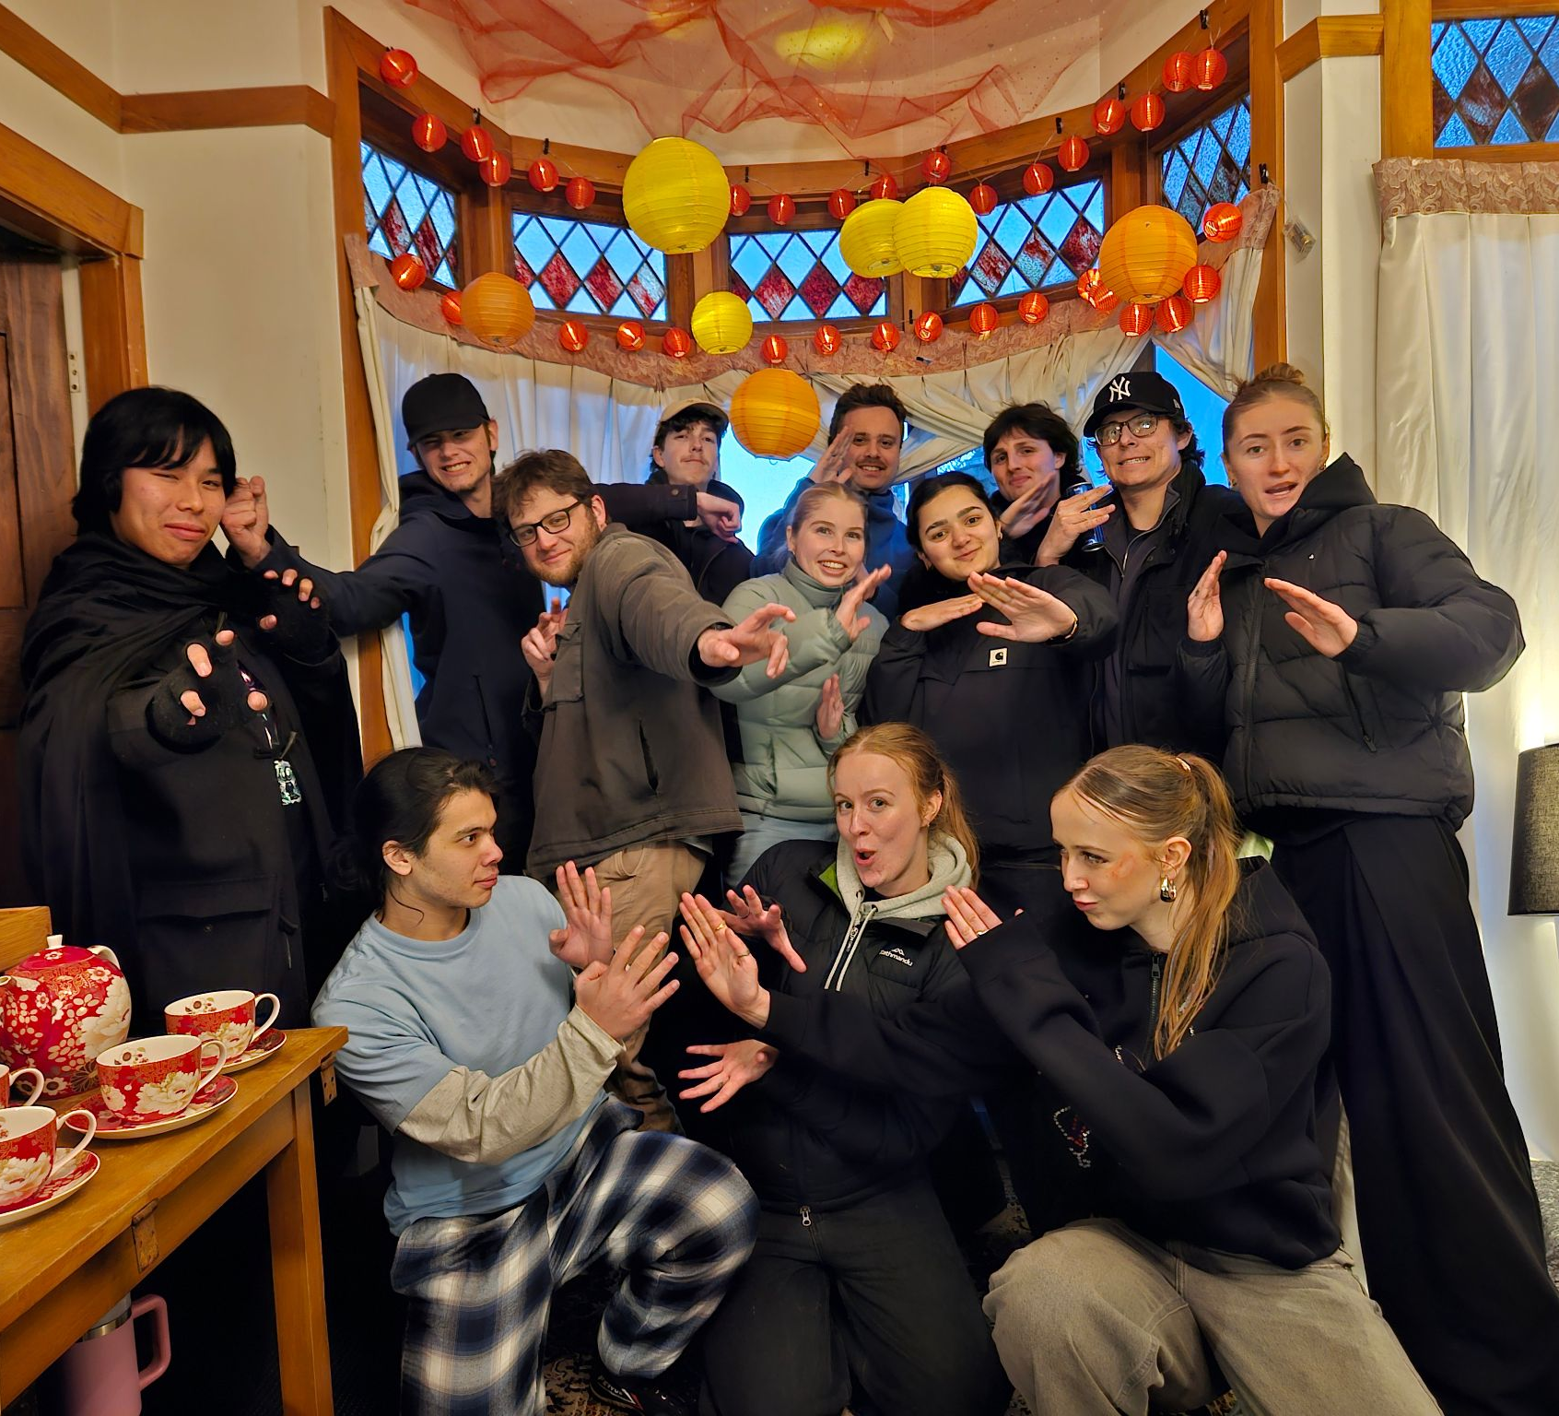
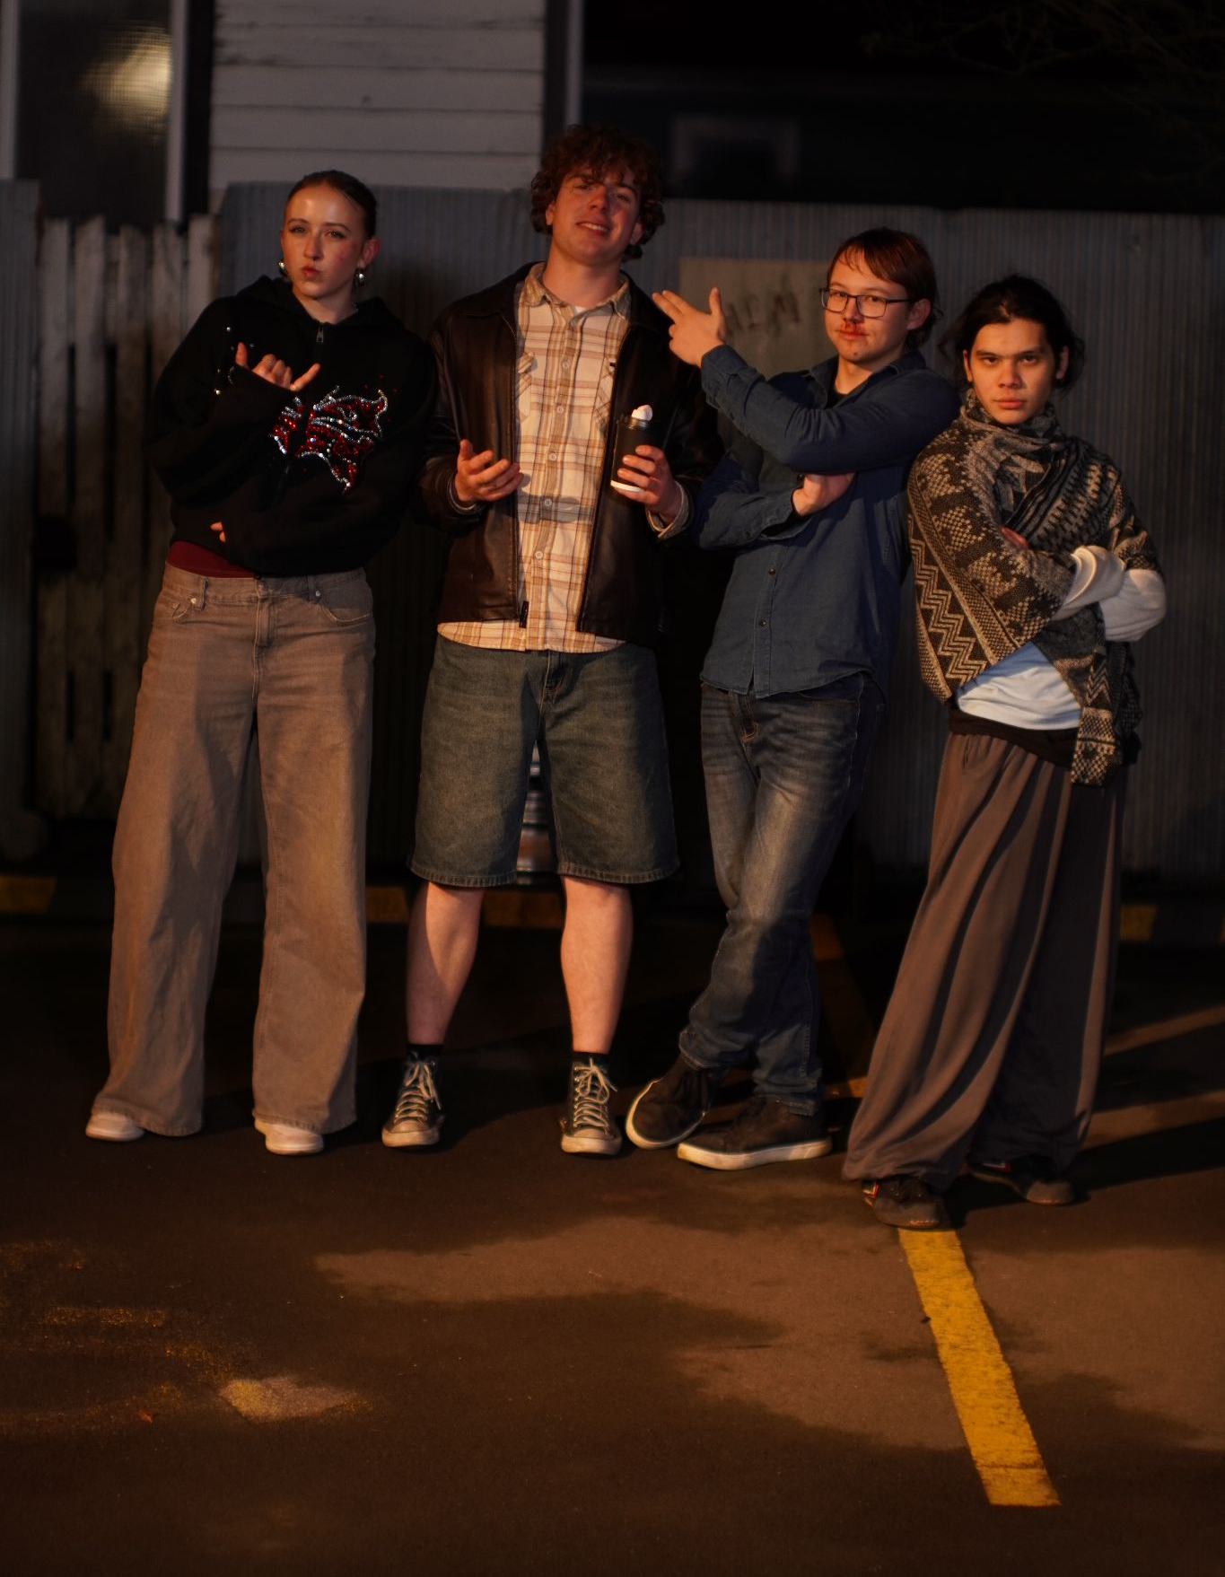
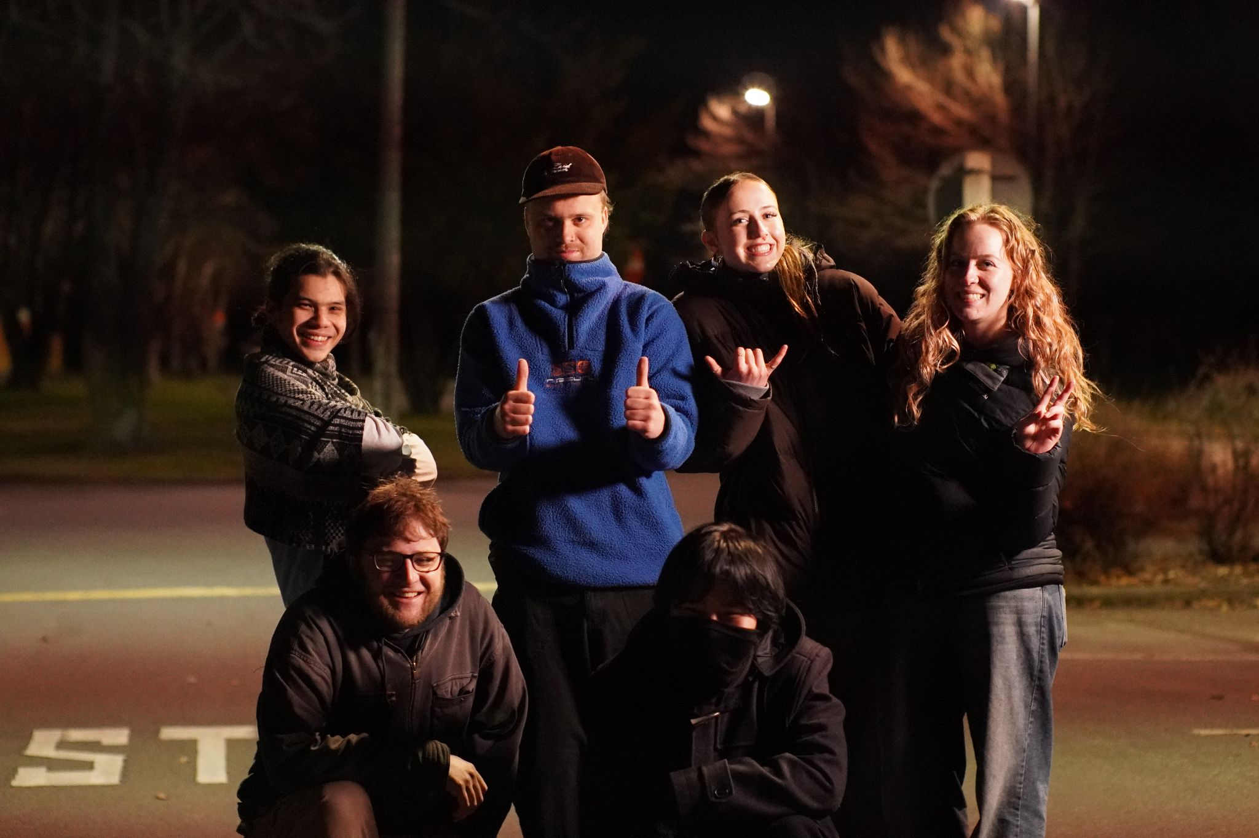
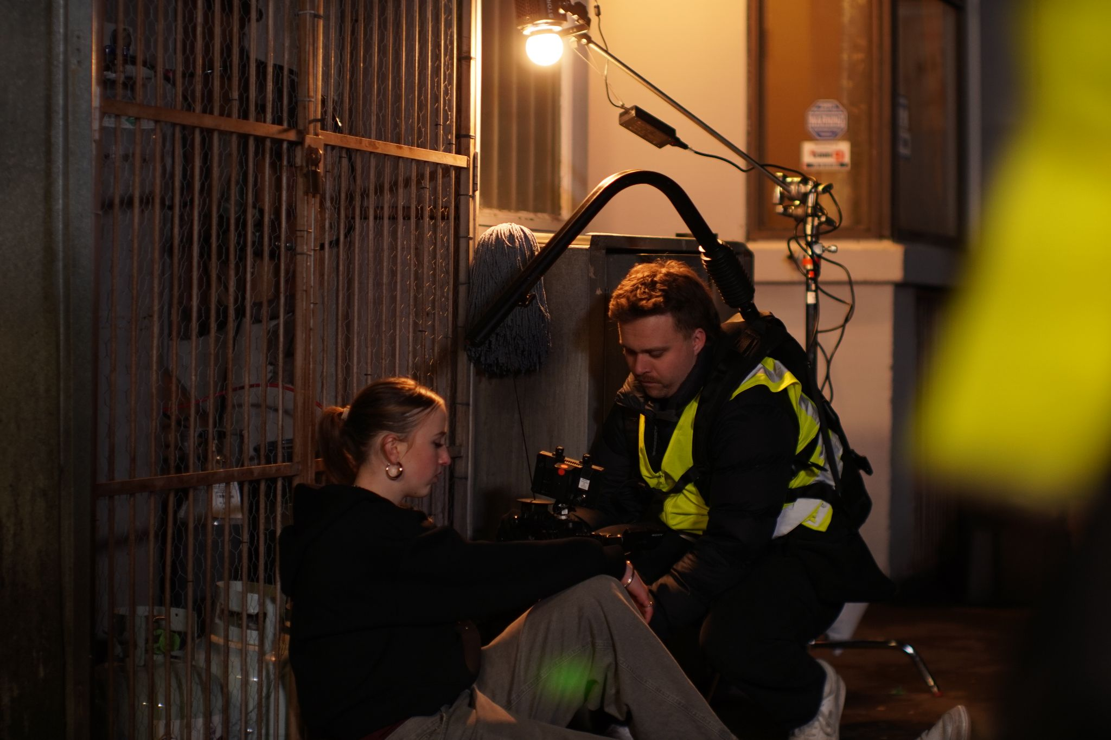
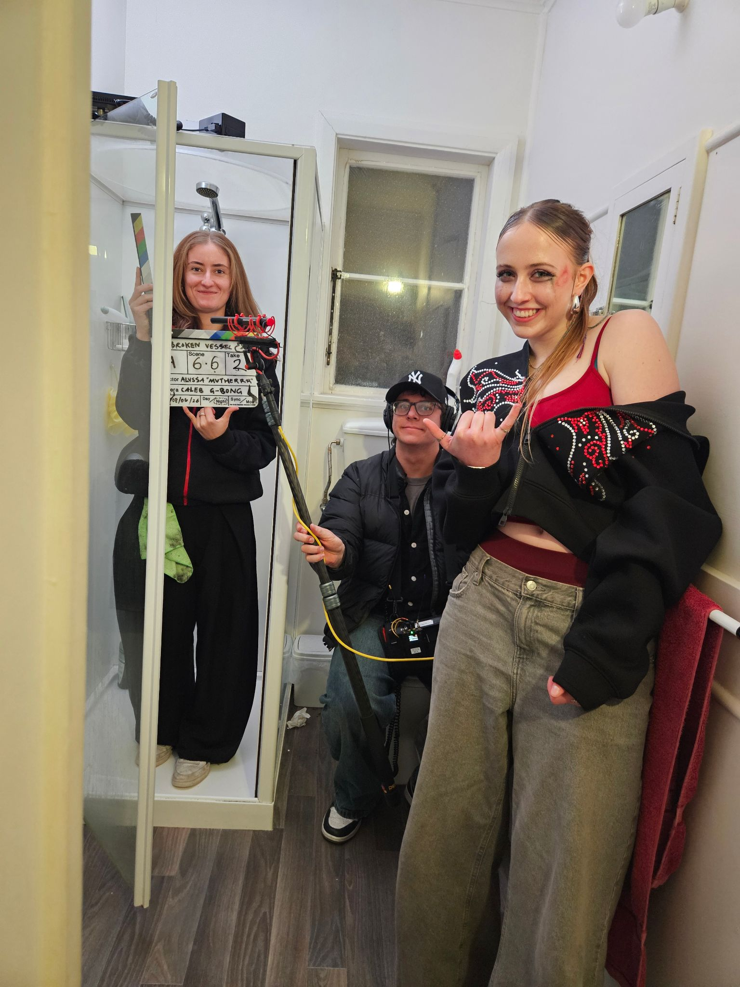
Alyssa Murphy
Director / Writer
alyssamurphynzp@gmail.com
+64 22 1885868
Caleb Gilbert
Director of Photography
caleblukeg@gmail.com
+64 22 169 8463
Junxi Cao
Co-Producer
abyssai493@gmail.com
+64 27 274 7362
Joshua Kent
Co-Producer
Joshua.kent787@gmail.com
+64 21 124 5503

